Slide 1


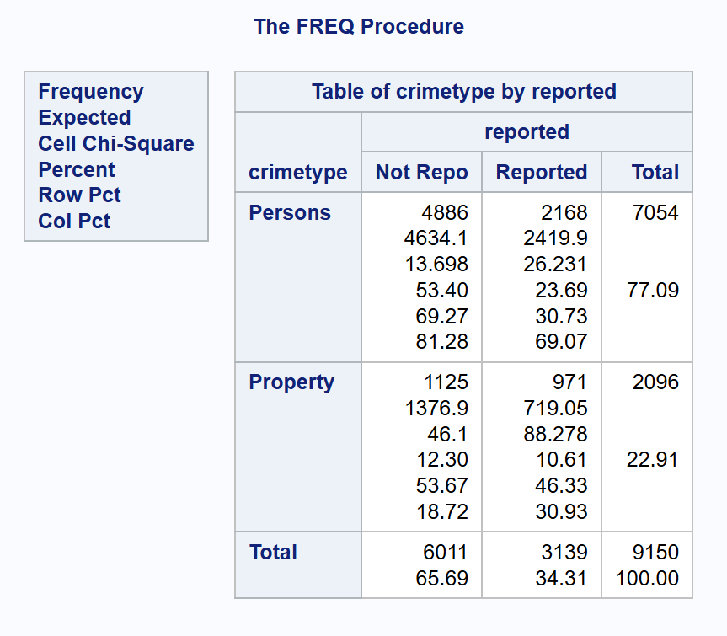
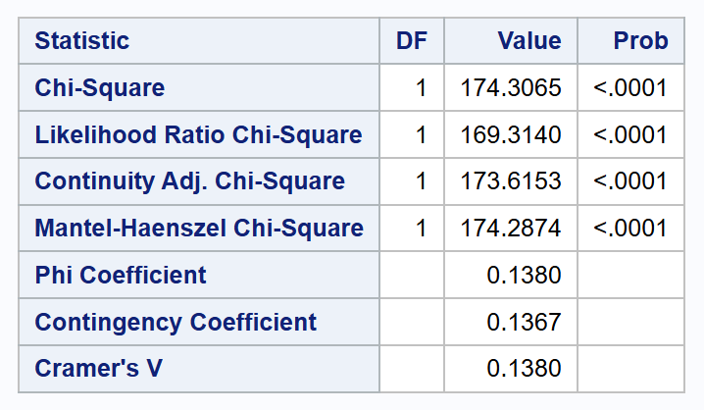
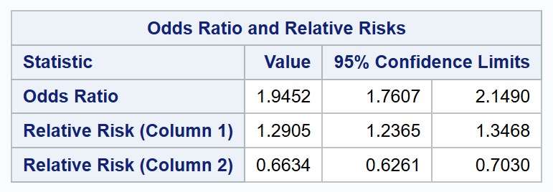
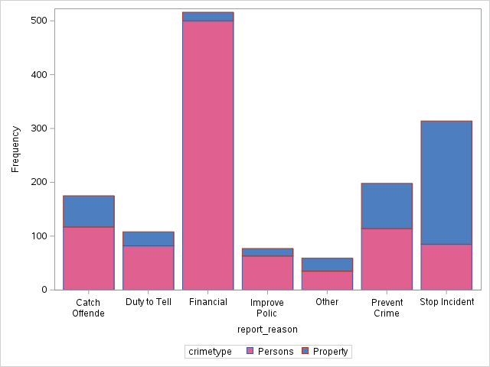
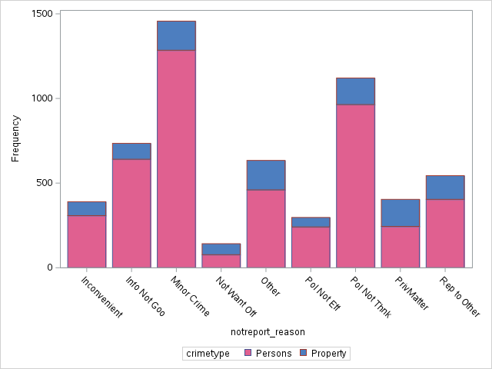
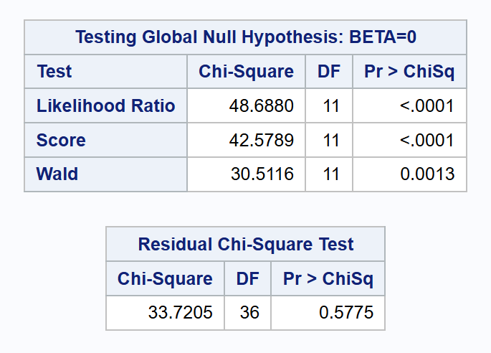
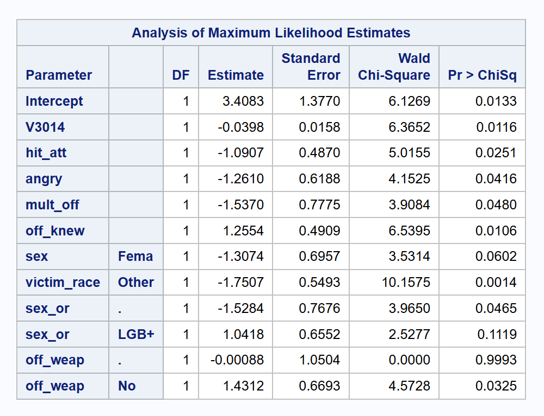
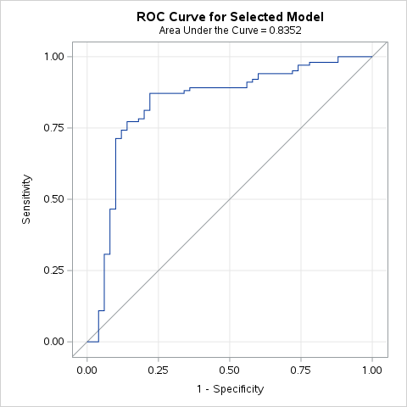
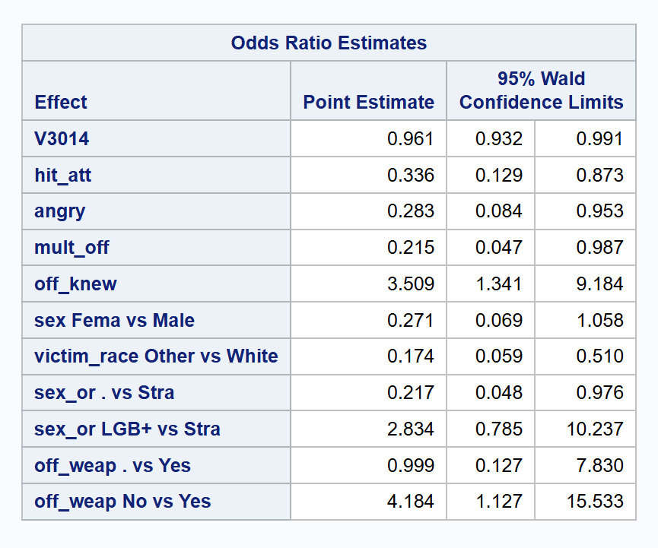
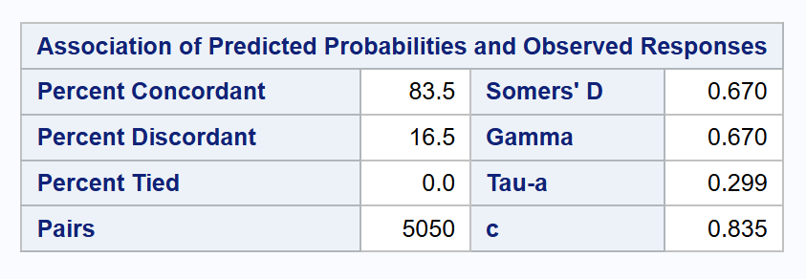


Trends in Reported Crimes – Do We Value Property Over People?
Megan Wilder – Expected Graduation: Spring 2025
INTRODUCTION
Prof. Michael Frankel
DISCUSSION
Content Warning: Mentions of S/A, no graphic details.
As modern societal issues have developed over the past several years, opinions on police efficiency and morality have grown increasingly divided. Many believe the police force is becoming corrupt, and others speculate that it always has been. Despite one’s positive or negative impression of our law enforcement system, it cannot be denied that society’s attitude toward safety and justice is being challenged. For this reason, it is important to investigate the current state of the relationship between crime victims and our judicial system. So, how does the general population’s feelings about the police affect their willingness and comfort to report crimes committed against them?
The dataset used for this project was sourced from the U.S. Bureau of Justice and contains survey-gathered information regarding citizens who were victims of a crime in 2021.
Tables and Figures
Chi-Square Test:
The results show that victims of property crimes are nearly twice as likely to report that crime than they would a crime against persons. This begs the question, “Do people value their belongings more than themselves?” To investigate potential ideas regarding this question, we can reference Figures 2 and 3.
Figure 2 shows that the most significant reason a crime was reported was for a financial reason. It can also be seen that the proportion of property crimes is larger for reasons relating to preventing or stopping a crime.
Figure 3 shows that the biggest reason crimes are not reported is victims believing the crime is minor. Other frequent reasons for not reporting crimes include thinking the police would not find the crime important, and victims lacking sufficient information to provide to police.
This information suggests victims tend to not consider personal harm or threats of personal harm as worth reporting to the police as crimes where a person was affected financially or crimes where there is reason to believe others may be harmed in the future. This does not necessarily mean that people view personal physical harm as less serious than financial harm, but it may suggest that people do not view personal physical harm as an issue for the police.
Binary Logistic Regression:
The results show that victims who know their offender are more likely to report sexual assault than those who were assaulted by a stranger. One potential explanation is that the victim feels that they have sufficient information to give police. Victims who are assaulted by strangers may feel like police will not care about their situation if they do not have a clear suspect for the crime.
Victims of sexual assault were also significantly more likely to report the assault if the offender used a weapon. The reason for this may be that the victim feels there is potential for future danger and thus want to report the crime. The victim may also consider the crime more serious if it involves a weapon.
In cases where there were multiple offenders rather than just one, victims were somewhat less likely to report sexual assault. This could be because the victim feels pressure from more people to keep quiet or may be because the victim does not know which offender(s) should be held responsible for the crime.
Victims of sexual assault in who were hit or attacked by the offender were somewhat less likely to report the crime. A potential reason for this might be that the victim feels shame or trauma relating to their injuries and may not want to be forced to use those injuries as evidence.
Lastly, the older a victim, the less likely they are to report sexual assault. This could suggest that the perception of the seriousness of sexual assault may differ between generations.
Conclusions:
We should be looking out for ourselves and others in our community, as we may not always prioritize our physical and mental health as much as we should. It is important to look out for signs that someone may be suffering physical or emotionally so that we can offer support that they may not feel comfortable asking for.
METHODS
Figure 1: Chi-square test results and odds ratio for whether a crime was reported by crime type.
A chi-square test was performed to determine whether there is a difference in the proportions of reported vs. non-reported crimes between crimes against persons and crimes again property (n=9150).
Two chi-square tests were observed. One tested persons vs. property crimes and is shown in Figure 1. The second tested persons vs. property w/ victim present vs. property w/ victim not present. This second test yielded similar results to the first and thus was not visualized.
The results of this test were found to be significant (p<.0001).
A binary logistic regression analysis was performed on a subset of the data looking at crimes that classify as sexual assault/rape to identify variables that affect whether a person did or did not report a crime (n=157) .
Due to the massive and complicated nature of the dataset, variables were manually selected as candidates for modeling by relevance to the research question. Variables were further narrowed down by their percentage of missing data.
Predictor variables were recoded and imputed in preparation for modeling.
A stepwise selection was performed to determine the final variables that remained in the model, which can be seen in Figure 7.
The resulting model was found to be significant (p<.0001) and has a c-statistic of 0.835.
Despite the magnitude of the dataset, this model is limited due to the small sample size of the subset.
Figure 2: Bar chart of frequency of crime type by reason the crime was reported.
Figure 3: Bar chart of frequency of crime type by reason the crime was not reported.
Figure 4: Logistic regression global hypothesis test.
RESULTS
Figure 7: Logistic regression variable estimates and p-values.
Chi-Square Test:
Victims of a crime are approximately 94.5% more likely to report a crime against property than a crime against persons. (Figure 1)
Binary Logistic Regression:
For every 1 year older a victim of sexual assault was, the likelihood that they reported the crime decreases by about 3.9%.
Victims who were hit or attacked by the assaulter were approximately 66.4% less likely to report the crime than those who were not.
In cases where there are multiple offenders, the victim is about 0.78% less likely to report a crime than if there is a single offender.
If a victim knew the offender, they were about 3.5 times more likely to report the crime than if they did not know the offender.
In cases where the offender had a weapon, victims were about 4.2 times more likely to report the crime than if the offender did not have a weapon.
Figure 5: ROC curve for final logistic regression model.
LINKS
Github:
LinkedIn:
Figure 6: C-statistic results for final logistic regression model.
Figure 8: Logistic regression variables odds ratio estimates.

